Slide 1
Equality as an Endpoint: Learning, Training and the Global Pathways to Inclusive Development
Professor Mike Osborne
Director of CR&DALL
University of Glasgow

Slide 2
British ACADEMY- Cities and Infrastructure Programme
Strengthening the Regional Engagement Role of Higher Educations in Africa and Asia. PI: Mike Osborne (Education), Co-Is: Muir Houston (Education), Kasia Borokowska (IDS), Lavinia Hirsu (Education), Neil Burnside (Engineering)
(South Africa, Zimbabwe, Tanzania, Iran, Iraq, Philippines)

Slide 3
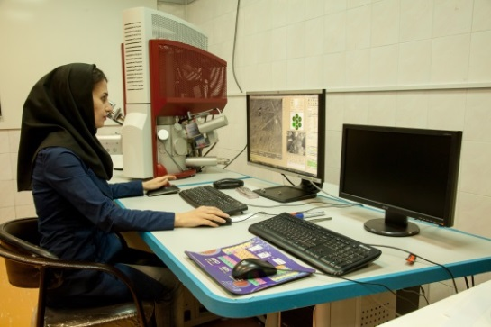
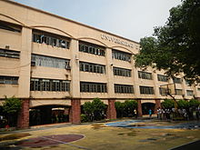
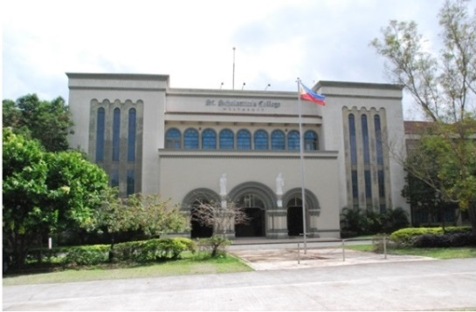
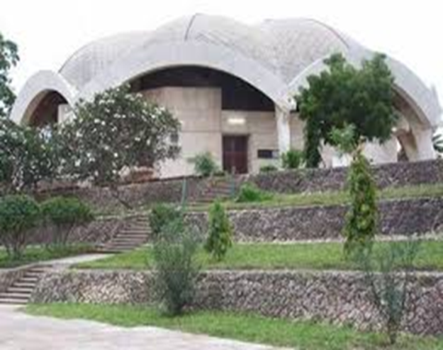
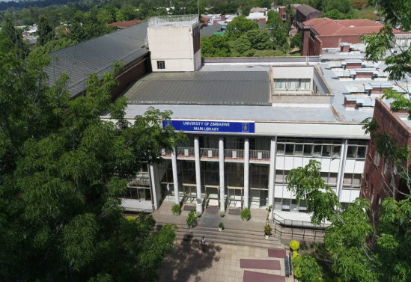
SUEAA Objectives
The project looks at the ‘third mission’ of Universities in cities in the Global South
Third Mission refers to activities which lie outside of research and teaching, which looks at the contributions of universities towards innovation and social change
Specifically, how Universities contribute to developing sustainable cities in the context of major social, cultural, environmental and economic challenges facing the Global South

Slide 4
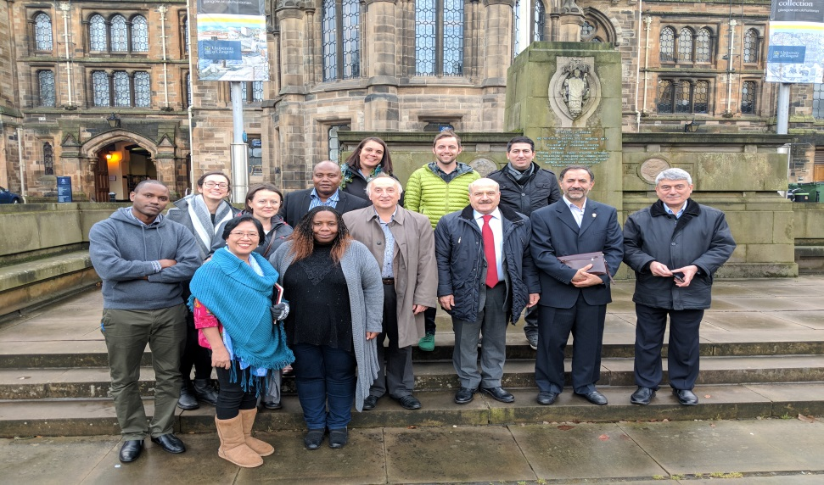
The importance of training
The team
Multi-lateral
Co-construction
Responsiveness to community needs and demands
Assessing needs
Translating research into practice
Translating research into policy

Slide 5
Global Urban Transformation
GCRF Centre for Sustainable, Healthy, and Learning Cities and Neighbourhoods (SHLC)
Sustainable Cities and Neighbourhood
Urbanisation, migration and development
Healthy and Resilient People and Environment
Learning and quality of Education
Urbanisation has been the main innovative driving force for development.
Future urbanisation will mainly happen in the developing countries of Asia and Africa.

Slide 6
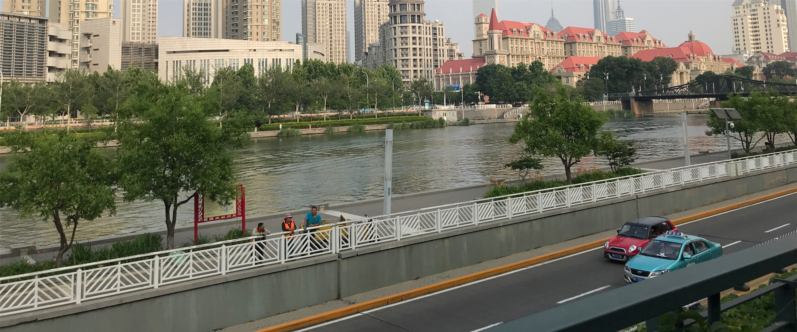

Slide 7
Emerging Issues for Education
Community/Neighbourhood provides a focus for:
Citizen-led community initiatives
Resident groups and associations for example in India and China
Illumination of ineffectiveness of fragmented policies that cross portfolios of city governance – internal power struggles
LLL for health and well-being
LLL for social control
The Importance of Infra-structure
Transport – 40% of income in South African cities spent on getting to work
Housing

Slide 8
Capacity Strengthening Packages
UK based methods training
Knowledge Exchange in between Countries
A visiting research fellow programme for both academics and policy makers
Research seminars, conferences and Network Building
Also a flexible responsive fund to address emerging issues in all developing countries

Slide 9
For work in cities
It is more than being ‘smart’, ‘creative’, ‘eco-friendly’ …
It’s about learning
It’s about engagement with community
The Quadruple Helix

Slide 10
For educators
It’s more than Skills
It’s about wider benefits
Health and well-being
Inclusion
But don’t think that these are dichotomous
It’s not just young people
But we cannot ignore the challenges for all age-groups

Slide 11
Automation, Jobs, Education, Skills, Health
Projected upward trends in automation leading to job losses
Disproportionately slower growth in creation of jobs as compared to growth in output
Poor outcomes in education, skill and health leading to an inability to harness the demographic dividend
Industrial Policy – 2017, A Discussion Paper, Department of Industrial Policy and Promotion, Ministry of Commerce and Industry, India

