Slide 1
SUEUAA – Strengthening the Urban Engagement of Universities in Africa and Asia Research Governance
Dr Muir Houston
29th August 2018
Manila,
The SUEUAA project (Reference CI170271) is funded by the British Academy under the Cities and Infrastructure programme, which is part of the Global Challenges Research Fund, itself part of the UK's Official Development Assistance (ODA) commitment.

Slide 2
Outline of session
What is Research Governance; and, why is it important?
What is Research Integrity: and, why is it important?
What are research Ethics; and, why are they important?

Slide 3
Research Governance
Research governance can be described as the broadly agreed framework of regulations, principles and standards of good practice that exist to achieve and continuously improve research quality
Why?
Provide a clear framework within which to conduct research; Promote good practice in research; Monitor practice and performance; Enhance scientific and ethical quality; Minimise risk in research; Safeguard participants in research; Protect researchers and investigators by providing clear guidelines for the conduct of research

Slide 4
Sets out principles, requirements and standards
Defines mechanisms to deliver them
Describes monitoring and assessment arrangements
Improves research and safeguards the public by: enhancing ethical awareness and scientific quality; promoting good practice; reducing adverse incidents; ensuring lessons are learned; and forestalling poor performance and misconduct
Is for all those who:
design research studies participate in research,
host research in their organisation fund research proposals or
manage/undertake research

Slide 5
What does it mean in practice?
Setting up training for students and staff in relation to issues of research integrity and research ethics.
Set up systems to review and monitor issues of integrity including research misconduct.
Set up systems to review applications for ethical approval

Slide 6
Research Integrity
Is focused on professional standards and responsible research conduct. It is relevant to researchers from all disciplines, as well as anyone supporting research (administrators, public engagement or communications specialists etc.).
All researchers have a professional responsibility to keep up to date with what this means for their discipline, and contribute to a culture of good research practice.

Slide 7
Four core elements
Honesty
Rigour
Transparency and open communication
Care and respect
UUK – The Concordat to Support Research Integrity
The Singapore Statement on Research Integrity (2010)

Slide 8
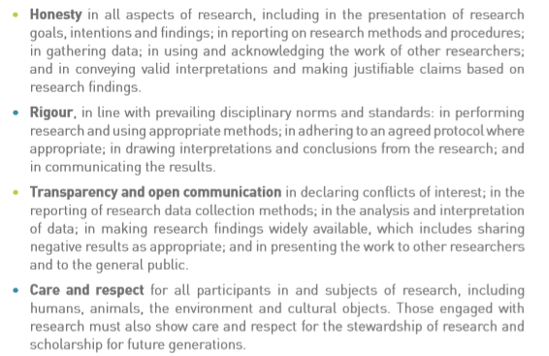

Slide 9
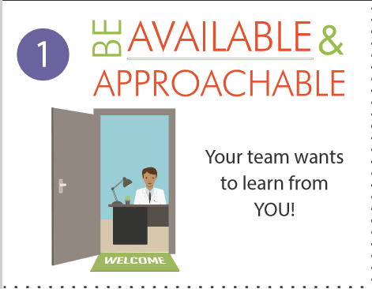
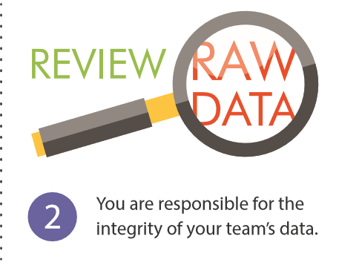
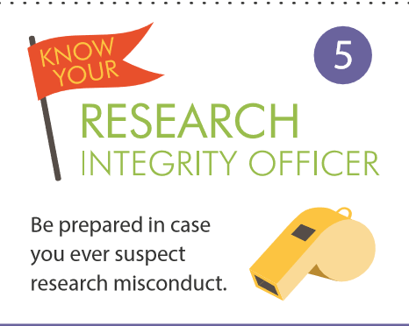
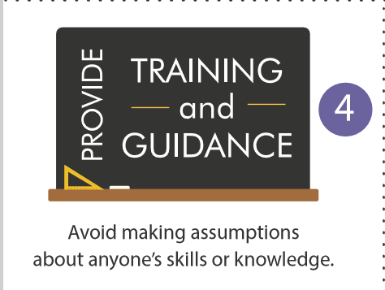
Tips for Supervisors

Slide 10
Research Ethics
Where do they come from?
Historical – Aristotle and Confucius – virtue ethics and living a good and moral life -
International – Nuremberg Code - Helsinki Declaration -
National – Research Frameworks – Research Councils -
Why do we need them?
Ethical Controversies
Protect participants
What do they look like?
Frameworks, guidelines and processes
Independent Review

Slide 11
The Helsinki Declaration (1964/…./2013)
Principles include but are not limited to:
The necessity of using an independent investigator to review potential research projects
The importance of preserving the accuracy of research results
Protect the privacy of research subjects and the confidentiality of their personal information.
Suggestions on how to obtain informed consent from research participants
All vulnerable groups and individuals should receive specifically considered protection.
See also The Belmont Report (1979) and the CIOMS Code (1982)

Slide 12
Why are they important (1)
Knowing what constitutes ethical research is important for all people who conduct research projects or use and apply the results from research findings.
All researchers should be familiar with the basic ethical principles and have up-to-date knowledge about policies and procedures designed to ensure the safety of research subjects and to prevent sloppy or irresponsible research, because ignorance of policies designed to protect research subjects is not considered a viable excuse for ethically questionable projects.
Therefore, the duty lies with the researcher to seek out and fully understand the policies and theories designed to guarantee upstanding research practices. (2003)
Notes:
Or sponsor – you may need to commission research and would need to be able to be confident that it was going to be conducted in an ethical manner.

Slide 13
Why are they important (2)
Research is a public trust that must be ethically conducted, trustworthy, and socially responsible if the results are to be valuable. All parts of a research project – from the project design to submission of the results for peer review – have to be upstanding in order to be considered ethical. When even one part of a research project is questionable or conducted unethically, the integrity of the entire project is called into question.
(University of Minnesota, 2003)

Slide 14
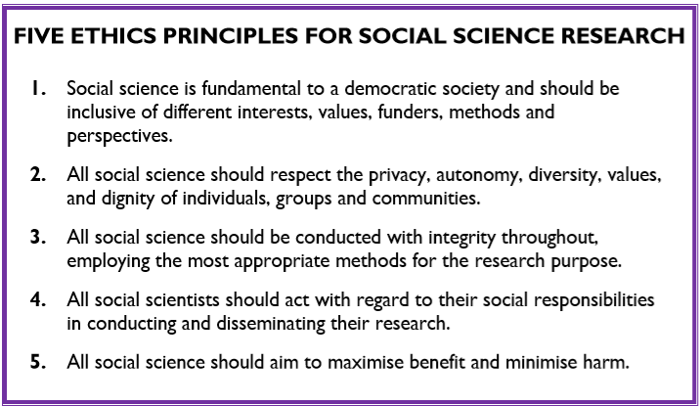

Slide 15
In order to maintain a climate of trust in the practice and outcomes of social research, it is inevitable that systems of ethical assurance will be established and will need to be maintained by all those engaged in work of this nature. The trust of the public, professional colleagues, those who commission and fund research and those being studied requires an effective system of ethical review, clear lines of responsibility and a manageable degree of independent overview. (Iphofen, 2011: p.5)
Iphofen, R. (2011) Ethical Decision Making in Social Research: A Practical Guide, New York: Palgrave MacMillan

Slide 16
Some controversies
Tuskegee Syphilis Study (1932-1972)
For forty years, from 1932 to 1972, 399 African-American males were denied treatment for syphilis and deceived by officials of the United States Public Health Service. (http://www.cdc.gov/tuskegee/timeline.htm)
Milgram’s Study of Obedience (1961)
The aim of the experiment was to investigate what level of obedience would be shown when participants were told by an authority figure to administer electric shocks to another person. (http://www.simplypsychology.org/milgram.html)
https://www.youtube.com/watch?v=yr5cjyokVUs&feature=youtu.be https://www.youtube.com/watch?v=wdUu3u9Web4
Stanford Prison Experiment (1971)
What happens when you put good people in an evil place? Does humanity win over evil, or does evil triumph? In only a few days, guards became sadistic and prisoners became depressed and showed signs of extreme stress. (http://www.prisonexp.org/)

Slide 17
Issues
Responsibilities to research participants
Anonymity and Confidentiality
Informed Consent
Vulnerable People/groups

Slide 18
Responsibilities to research participants
Minimise disturbance to both those participating in the research and to their relationships with their environment and those gatekeepers who may control access to participants -since these relationships will continue long after the researcher has left;
Take special care where research participants are particularly vulnerable by virtue of age, social status and powerlessness;
Take care to avoid falsification or misrepresentation of evidence, data, findings or conclusions;
Clarify with participants the extent to which they are allowed to see transcripts of any interviews and field notes and to alter the content or interpretation of the data.

Slide 19
Anonymity and Confidentiality
Anonymity refers to concealing the identities of participants in all documents resulting from the research;
Confidentiality is concerned with who has the right of access to the data provided by the participants.
In practice:
Anonymity and privacy should be respected. This means that care should be taken in deciding whether or not sensitive information should be recorded;
Identities and research records should be securely stored and possibly encrypted

Slide 20
Informed Consent
Informed consent entails:
“…. giving sufficient information about the research and ensuring that there is no explicit or implicit coercion so that prospective participants can make an informed and free decision on their possible involvement. Information should be provided in a form that is comprehensible and accessible to participants, typically in written form, and time should be allowed for the participants to consider their choices and to discuss their decision with others if appropriate. ” (ESRC, 2015)
Consent needs to be:
Informed: given in possession and understanding of the principal, relevant information;
Voluntary: given freely and not as a result of coercive pressure (real or perceived);
Competent: given by somebody able, in virtue of their age, maturity and mental stability, of making a free, considered choice.

Slide 21
Limits to confidentiality, suggested wording when preparing documentation for participants
Confidentiality will be respected subject to legal constraints and professional guidelines.
Confidentiality will be respected unless there are compelling and legitimate reasons for this to be breached. If this was the case we would inform you of any decisions that might limit your confidentiality.
Confidentiality may be limited and conditional – and the researcher has a duty of care to report to the relevant authorities possible harm/danger to participant or to others.
Assurances on confidentiality will be strictly adhered to unless evidence of wrongdoing or potential harm is uncovered. In such cases the University may be obliged to contact relevant statutory bodies/agencies.
+ Sample considerations

Slide 22
Vulnerable participants
Issues regarding research with children, with emphasis on the importance of gaining informed consent from the children themselves (as well as from their legal guardians).
Special issues apply when working with people with learning disabilities, suffering from senile dementia or other forms of diminished cognitive ability.
Circumstances in which consent by proxy is necessary and justified, and the criteria for evaluating which people have the right to make decisions.
The bearing that institutional dynamics have on gaining informed consent with particular reference to voluntarism and subtle or explicit pressures of compliance.

Slide 23
Consent forms and PLS
Information about the nature and purpose of the research;
A statement that participation is voluntary, including the choice to opt out of the research at any time;
Information about the data collection method and the option to agree/refuse to being recorded (if applicable);
A description of the extent to which confidentiality will be maintained and an option to choose anonymity;
A description of any possible risks or discomforts to the participant;
A description of any possible benefits to participant or others;
Contact details for any questions about the research;
An option to agree or refuse to participate (signature of participant, date, signature of witness/researcher);
A description of the intended uses, and disposal/storage/access and documentation procedures for data including an option to agree/disagree with these procedures.

Slide 24
Data sharing and access
Increasingly funders require data to be archived and made available to other genuine researchers with varying conditionality attached
Is this stated on PLS?
Did you get specific consent for this?
If yes, what are archival and access issues and conditions of use?
http://www.data-archive.ac.uk/create-manage/consent-ethics/legal?index=6

Slide 25
Documentation outlining consent has to differentiate between consent to participate and consent to allow data to be published and shared. (UK Data Archive)
I agree for the data I provide to be archived at the UK Data Archive/University of Glasgow Secure Data Repository.
I understand that other genuine researchers will have access to this data only if they agree to preserve the confidentiality of the information as requested in this form.
I understand that other genuine researchers may use my words in publications, reports, web pages, and other research outputs, only if they agree to preserve the confidentiality of the information as requested in this form.

Slide 26
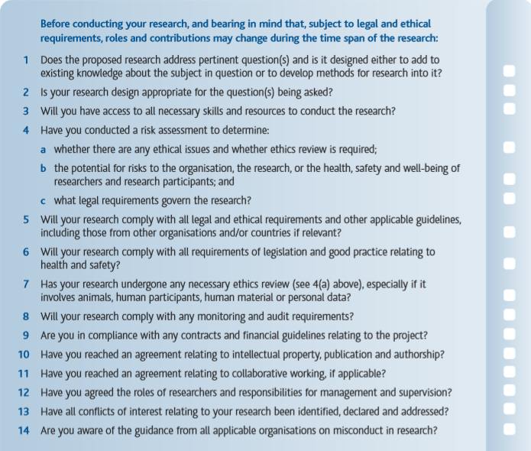

Slide 27
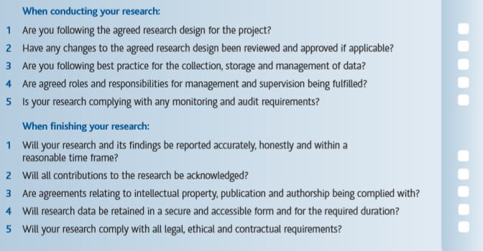

Slide 28
Finally
“Social scientists do not have an unalienable right to conduct research involving other people (Oakes, 2002). That we continue to have the freedom to conduct such work depends on us acting in ways that are not harmful and are just. Ethical behaviour may help assure the climate of trust in which we continue our socially useful labours (AAAS, 1995; Jorgensen, 1971; Mitchell and Draper, 1982; PRE, 2002; Walsh, 1992). If we act honestly and honourably, people may rely on us to recognize their needs and sensitivities and consequently may be more willing to contribute openly and fully to the work we undertake.” (Israel and Hay, 2006: p3)
Israel, M. and Hay, I. (2006) Research Ethics for Social Scientists, London: Sage.

Slide 29
Some references:
https://www.futurelearn.com/courses/academic-integrity MOOC
https://www.eur.nl/en/about-eur/policy-and-finance/integrity-code/dilemma-game
http://byglearning.co.uk/mrcrsc-lms/course/category.php?id=1
http://ukrio.org/publications/checklist-for-researchers/
https://ori.hhs.gov/images/ddblock/Supervisor%20tips%20-%20FINAL.pdf
http://ori.hhs.gov/THELAB (has Chinese and Spanish versions)

