Slide 1
University Response to City Issues: UOK and Sanandaj
Nematollah Azizi

Slide 2
Context of the city: Historical background
The history of Sanandaj dates back to the fourth millennium BC (Copper and Medieval times). This has been approved by Archaeological investigations which were carried out in two hills located on the eastern side of Sanandaj and near the Griashan River, in the lands of Dagiran.
In 1673 Sanandaj was formally announced as the Capital City of Kurdistan during the Safavid period and at the time of Shah Safi, Soleiman Khan Ardalan. Since that they transferred the center of government from the castles of Hassanabad and Palangan in southern Sanandaj to Seneh (Sanandaj).

Slide 3
Context of the city: Socio-cultural background
In terms of social background the people of sanandaj enjoys the community’s lincreasing social capital based on trust, recognition and interaction among people. Despite politically denied and ignored nation and increasing poverty in Kurdistan, Kurdish people are happy and active.
The city of Sanandaj has a special status among the Kurdish regions in terms of culture, art and religion. The number of top artists of various cultural and artistic fields such as music, and theater and visual arts, the great position of religion in the city and the printing of Kurdish publications, indicate Sanandaj’s cultural potential.
Sanandaj with 141 mosques has the highest number of mosques compared to the population among Islamic countries.

Slide 4
Context of the city: Demographics
Population: over half million
Unemployment: 40% youth unemployment
Poverty: nearly 50% of population live in less than one third of the city’s areas including marginal and informal settlements.
High migration rate at the national and international levels, as a result of country’s underinvestment policies

Slide 5
Context of the city: Geography
The height of the city of Sanandaj is 1480 m above sea level and its average rainfall is over 500 mm per year. Sanandaj is one of the beautiful cities of Iran, due to its special status, with its beautiful hills and mountains. It is called the City of Thousand Hills. It is composed of several hills and is located on every beautiful pond with beautiful views of the city.

Slide 7
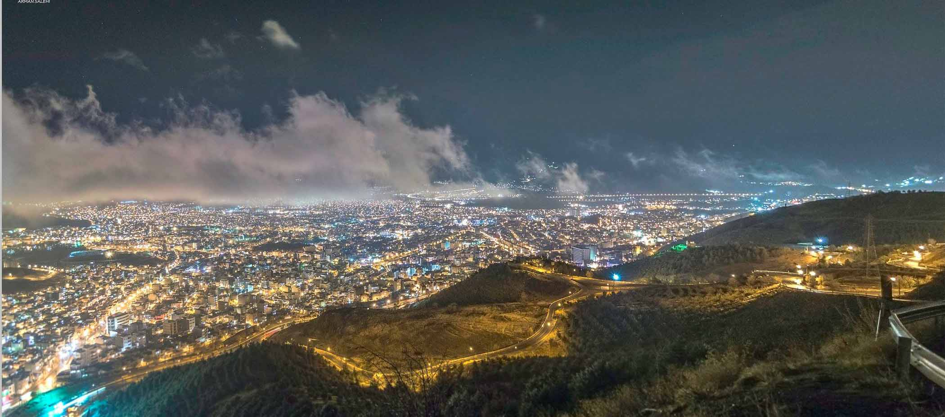

Slide 8
Main Issues Affecting Sanandaj
Environmental (environmental mismanagement ,-dust, waste, and climate change) ;
Social/Cultural (depressed and hopeless) ;
Population (young population, high illiteracy rate in the country,
Health (health indicators has been improved, infant mortality lowered and life expectancy increased to 76 in 2015 ;
Economic; (rich in oil, gold and other minerals resources but low income, unemployment, poverty)
Political (ruling minorities and discriminative and unjust policy

Slide 9
Study Methods (1)
(University participants included describe the fieldwork undertaken- include details such as position of participants/location in the university/city, your rationale for this recruitment)
Participants | Sex |  |  | Age |  |  |  | Occupation |  |  |  |  | Seniority |  |  |  | Total
 | Male | Female | Unanswered | 18-35 | 36-50 | 51-65 | Unanswered | University | Local Government | Local business | Voluntary Sector | Other | Entry level | Supervisor | Manager | Senior Executive
UOK (Iran) | 21 | 2 | 0 | 5 | 13 | 5 | 0 | 12 | 9 | 1 | 1 | 0 | 3 | 2 | 13 | 5 | 23

Slide 10
Study Methods (2)
The University’s Elite include
President of Teacher Education University (Farhangian University),
Vice-chancellor for Finance (UOK),
Vice Chancellor for Drug and Treatment (Kurdistan University of Medical Sciences ), and
Head of Growth Center (UOK)
The University’s Focus Group includes
Dean of Faculty of Urbanism and Architecture,
Head of Science and Technology Park,
Advisor of the UOK’s President,
Head of Research Center for Kurdistan Studies
Head of Free and night Courses (UOK’s Second Campus)
Deputy of Education ( Faculty of Humanities and Social Sciences),
an academic member from Department of Civil Engineering,
and an academic member from Department of Agriculture Economy.

Slide 11
Study Methods (3)
The City’s Elite include
Mayor of Sanandaj;
Head of Sanandaj City’s Council;
Director General of Crisis Management; and
A senior member of NGO in the field of environment.
The City’s Focus Group include:
Four members of Sanandaj City’s Council;
Head of the City’s Investment Commission
Deputy of Mayor;
An entrepreneur;

Slide 12
How does the Kurdistan’s HEIs interact with the city?
Despite some contradictions among the city’s representatives and the university’s ones regarding the ways by which HEIs are approaching the city, almost HEIs in Sanandaj have reported several forms of collaborations with different organizations which operate in Sanandaj. These practices which varies from university to university as well as from department to department include
Direct intervention
Sharing resources
Lending expertise

Slide 13
Opportunities and barriers for engagement
Both city and university’s elites have raised the importance of close collaboration to provide practical bases towards solving the city’s critical issues. This must go beyond the MoUs.
(reflecting on the information from the participants- what did they describe as the opportunities and barriers for closer partnerships between University and City)

Slide 14
Discussion
(how can we move this agenda forward, did engaging in these discussions promote change in thinking, what do you think needs to change in the University/city engagement strategy and activities? What is missing or needs to change?)

Slide 16
Thank you
Questions and Comments

