Slide 1
Strengthening Urban Engagement of Universities in Asia and Africa (SUEUAA)
University of Duhok Presentation
Professor Dr. Kamal Ketuly
Dr. Sizar Abid Mohammed
at Philippine Normal University
Manila-Philippines
27-29 August 2018

Slide 2
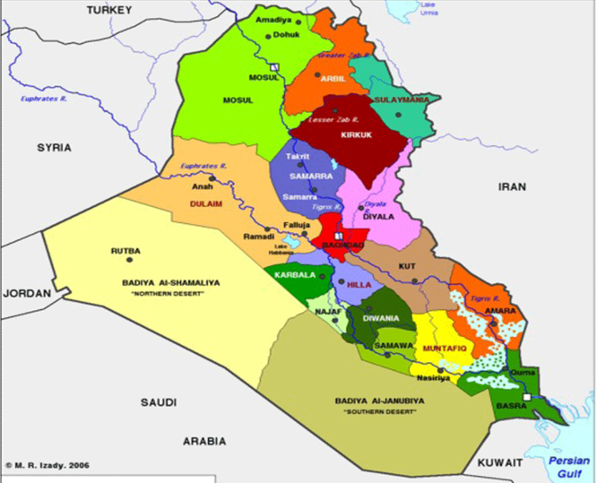
Map of Iraq Euphrates and Tigris

Slide 3
Regional Portrait
Duhok is a part of the Kurdistan region of Iraq and the capital city of Erbil. The Kurdistan region is a federal state within federal Iraq. The area of the city is about 1075 km² and contains mainly native Kurdish people and minorities of Assyrians, Armenians, Turkmans and Arabs. The main religion is Islam while in the area there are also Christian orthodox and Catholics, Jews and old Kurdish religions, Yazidies and Kakais. Duhok has many mosques, monasteries and churches.

Slide 4
The interviews and the outcome with the partner expert groups in Duhok
Duhok Government departments.
Universities colleges: University of Duhok and Duhok Polytechnic University.
Private sector.

Slide 5
Duhok Government Departments
1- Directorate of Landmine Department.
The Environmental Impact of Conflict and Landmine Clearance
The Kurdish region faces a threat composed primarily of landmines. The estimated numbers of planted landmines are about five million: majority emplaced during the Iran-Iraq war of 1980-1988 and internal suppression by Saddam Hussein.
The Iraq Landmine Impact Survey confirmed that all three of the governorates in the northern region of the country known as Iraqi Kurdistan were extensively contaminated.

Slide 6
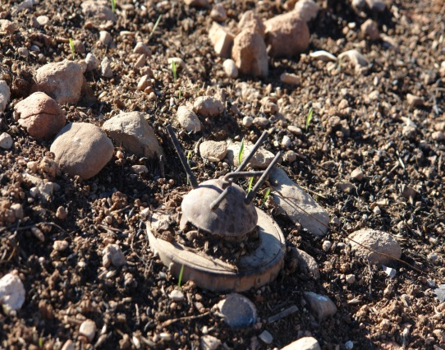
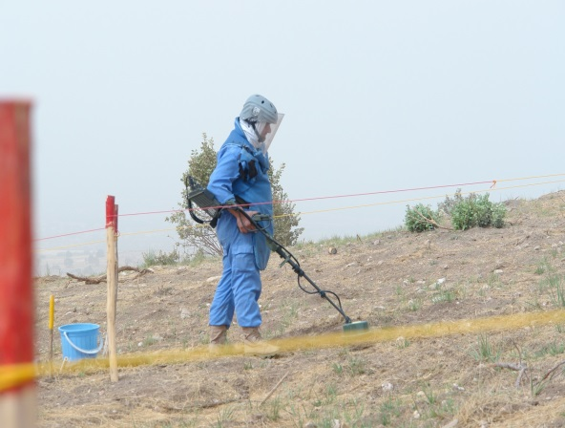
Figure 1: Landmines Department – Duhok Governorate – Iraq
Figures 2: Landmines Department – Duhok Governorate – Iraq

Slide 7
Duhok Environment Directorate is attempting to reduce the effect of the various sources of pollutants from these various sources as follows:
The establishment of waste water treatment plants, septic tanks and special ones for the industrial projects.
To enforce on each industry to build waste treatment plants for their liquid and solid wastes and to build in the required filters for their fumes outlet.
To improve overall sanitation and clean water provision overloaded infrastructure exacerbated by IPD

Slide 8
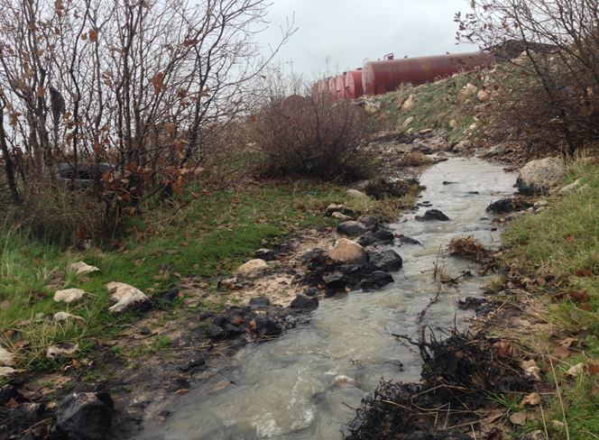

Slide 9
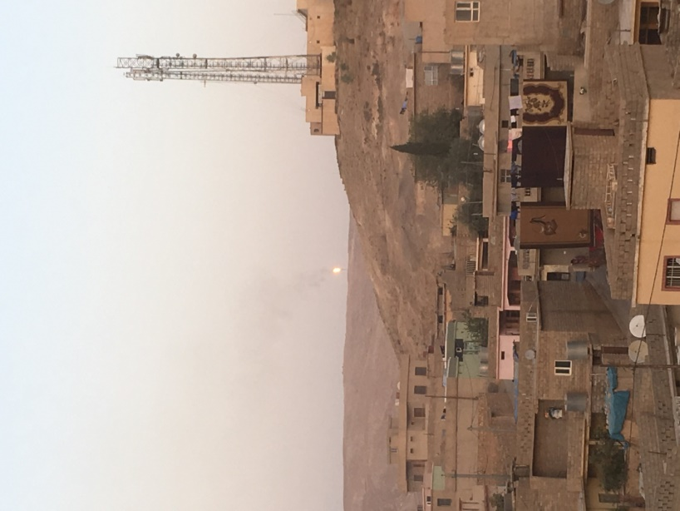
The flared gases from the oil well in Shekhan district – Duhok Governorate over populated area.

Slide 10
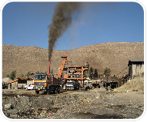
• Monitoring of the air pollution

Slide 11
The Eco-Gardens Projects
The Eco-Garden of Duhok City Zawa mountain and in Zawita Forests - northern region of Iraq project, selected site is located in the north aspect of the Zawita Mountain, Duhok district. It is forming a small natural forest about 25000 m2 in limestone foothills to try and address some of the environmental damage, through reforestation and species and habitat conservation and increase sustainability. The site is 16km from Dohuk city center.

Slide 12
Duhok City with Zawa mountain

Slide 13
Directorate of Planning Department
Duhok Metro and Duhok Park Projects:
They are planning with collaboration of the engineers experts at Duhok University to establish the metro network in Duhok city.
This project will also be implemented to reduce the congestion and pollution of cars and buses as well as improve movement of students and staff.
Directorate of Agriculture Small Dams and Irrigation Projects.
The Duhok Department of Agriculture and the college of Agriculture, University of Dohuk jointly are embarking on projects to build small dams and irrigation projects.

Slide 14
College of Basic Education: Joint Program with Germany- Oldenburg University
The Core of this project is the newly implemented study course at University of Duhok„ Disability Studies and Rehabilitation”
Courses for Trauma and Psychological rehabilitation for the IDP and refugees.
Through German humanitarian agencies once a week a group of undergraduate Psychology students go to the IDP and refugees camps in Duhok and they conduct their rehabilitation and psychology programs there.
Training courses for refugees children.

Slide 15
College of Medicine
The colleges of Medicine, Pharmacy, Dentistry, and Nursing at UoD had to coordinate with Duhok City Health Authority to provide health services and protection for about 800,000 IDP
College of Engineering
They coordinate their civil engineering programs with Duhok city authorities in the development of water irrigation, water supply from Duhok and Mosul Dams, the rivers purification, distribution systems, waste water treatment, roads, highways projects and modern residential areas.

Slide 16
3- Private sector The fibre optic strategic project for Duhok city
Korak Telecom Co. with the Directorate of Statistics, have jointly planned and implemented and completed in 2017 the fibre optic project for the whole of Duhok city. This project has linked all the departments of the city together electronically as well as linking them with the University of Duhok

