Slide 1
PUBLIC LECTURE INTERDISCIPLINARY UNIVERSITY-COMMUNITY ENGAGEMENT: A Design And Technology Education Perspective Presenter: Professor Charles Muchemwa Nherera Venue: Faculty of Education Lecture Theatre Date: 18 May 2018
UNIVERSITY OF ZIMBABWE
Faculty of Education
Department of Technical Education

Slide 2
Situation Analysis: A paradox of poverty and underdevelopment on a rich continent
Africa is endowed with mineral and other natural resources.
Thousands of successful candidates graduate each year while underdevelopment, poverty, hunger, corruption and numerous other challenges persist across the ‘rich’ continent.
The role of universities in national development is under increasing scrutiny internationally.
Public and private sector stakeholders; students, parents, legislators, and the general populace question the quality and relevance of university education.

Slide 3
Zimbabwe universities total output in 5-year periods from 1980-2014
Figure 2: Total output of graduates from all universities from 1980 to 2016 (computed from MoHTESTD raw data)

Slide 4
Zimbabwe universities post-graduate output in 5-year periods from 1980-2014
Figure 1: Output of post-graduate degree holders during the period 1980 to 2016 (computed from MoHTESTD raw data)

Slide 5
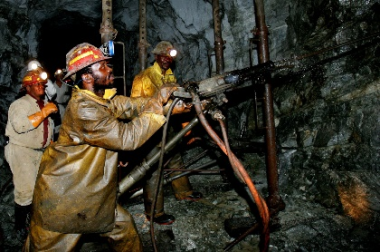
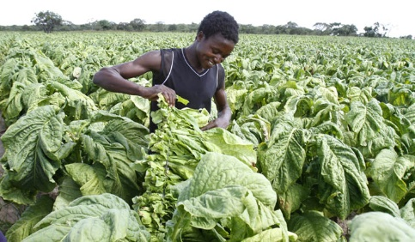
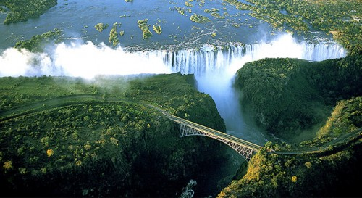
Zimbabwe Economy, industries and employment features
MINING
INFORMAL TRADING AND INDUSTRY
AGRICULTURE
TOURISM

Slide 6
Contribution Towards the Missing Link - Conceptual Framework
University-Community Engagement – 3rd Mission
Interdisciplinary Research - crumbling academic silos
Fourth Industrial Revolution / Industry 4 (IR 4.0)-focused community engagement

Slide 7
University-Community Engagement – 3rd Mission
The third mission refers to one of the three pillars that form the key functions of a university – Community Service (Engagement).
In practice, institutions tend to focus on the first two functions, i.e.
Teaching (Preparation of human capital – the 1st Mission), and
Research (producing new knowledge - the 2nd Mission).
There has been a shift from ‘service’ to ‘engagement’ to emphasise the two-way process.
Universities are increasingly expected to be more active in addressing socio-economic needs at both national and global levels – to be more relevant.

Slide 8
Unpacking University-Community Engagement
Meaning and nature of ‘community’ from a research perspective.
Meaning and nature of ‘engagement’ from a research perspective.
University-Community engagement from a research focus. Simply referred to as CE.
Change of perception of CE;
From university as ‘expert’, to
emphasis on community engagement and co-production of knowledge. - two-way process
opportunity to re-examine and advance Indigenous Knowledge Systems (IKSs).

Slide 9
Conceptualising Community Engagement
‘Communities’ are specific, collective interest groups that could potentially partner with universities, e.g. residential area, industry, city, or province.
Perceptions of Community Engagement (CE) vary, based on their contexts, processes, frameworks and strategies.
Differences also arise from the degree to which CE features as a core activity across all key functions of a university.
The South African Higher Education Quality Committee refers to CE as initiatives and processes through which teaching and learning as well as research are applied to address community needs.
CE is often regarded as comprising merely; add-on, nice-to-have, philanthropic activities – there is resistance to integrate it as a core function in the academic field (Bender, 2008). Regarded as not scholarly enough.
Deteriorating economies have led to increased scrutiny regarding the key roles of universities, with increasing calls for them to be more active in addressing national socio-economic issues.
Different models of CE have been adopted by universities, such as; Silo, Intersecting, and Infusion (Bender, 2008; Musinguzi, 2016).

Slide 10
The Silo Model
The three key roles of a university; teaching & learning, research, and community service are regarded independently.
CE is viewed as the least important of the three performance areas (Burton, 1998) as evident in promotion criteria and ranking of universities.
CE is often limited to outreach projects and student/staff voluntary or charity work and is seldom included in criteria for the assessment and certification of students.

Slide 11
The Silo Model
Research
Teaching
Community Service
Figure 1: The Silo Model of CE (Adapted from Bender, 2008)

Slide 12
The Intersecting Model
The three roles of universities – teaching & learning, research, and community service, are intersectional or interlocking.
Universities are assumed to be routinely engaging with communities directly and/or indirectly through their teaching & learning and research.
Increasing calls to focus on;
interdisciplinary, multidisciplinary and trans-disciplinary research (Caldwell, 2015);
an increasing focus on problems, rather than techniques; greater emphasis on collaborative work and communication; and greater emphasis on more diverse and informal modes of communication (Houghton, Steele & Henty, 2003; Moore, 2011).

Slide 13
The Intersecting Model
Community
Teaching and Learning
Engagement
Research
Service
Community- Based Research
Service Learning
Community
Outreach
Voluntary Work
There are calls to move beyond traditional modes and scope of engagement
Figure 2: The Intersecting Model of CE
(Adapted from Bringle, Games and Malloy, 1999)

Slide 14
The Infusion (cross-cutting) Model
Also referred to as the ‘community-engaged university’.
Recognises only two key roles of a university as teaching & learning, and research.
Teaching & learning, and research, are embedded in the context of CE; and CE in turn is enriched through the knowledge base of teaching & learning, and research (Higher Education Quality Committee / JET, 2007).
CE is the overriding goal of higher education and is therefore infused in and integrated with teaching & learning, and research. The three in turn conversely informing each other.
However, ‘community’ should be defined broadly to avoid narrowing university activities and care taken to remain proactive, beyond immediate ‘community needs’.

Slide 15
The Infusion (cross-cutting) Model
Engaged University
Teaching
and
Learning
Research
Community
Engagement
Service Agency / Community
Partnerships & Collaboration
The Infusion (Cross-Cutting) Model of CE (Adapted from Bender, 2008)

Slide 16
Holistic Approaches to Community Engagement
Real challenges and issues in communities require interdisciplinary interventions.
For instance addressing an outbreak of an epidemic such as cholera will require expertise from diverse fields such as; medicine, engineering (civil, mechanical, electrical), hydrology, family science, social work, sociology, media.
Solutions proffered by a team of interdisciplinary experts are more comprehensive and long lasting.
There is need for flexibility in adoption of community engagement strategies – no fixed model. Accept there are other ways of knowing and irreconcilable notions of truth.
Academics are increasingly embracing interdisciplinary approaches to their research, teaching and CE.

Slide 17
Interdisciplinary Research and Engagement – Breaking out of our academic silos
Yale University 2013 Nobel Laureate, Robert Shiller observes, “…many professors...teach only their own department's scholarly material, without attention to wider aims,....” (Fram, 2015).
Shiller advocates that course contents should be more rigorous and multi-disciplinary, rather than remain confined to a department's scholarly materials (Fram, 2015).
According to Linton, (2009) many academics suffer from “… the silo effect … isolated in their own little part of their academic neighborhood and consequently experience minimal interaction with colleagues” – socially and psychologically unhealthy and academically less productive.
Increasing calls for papers now require the creation of Interdisciplinary Research Hubs to tackle issues holistically (e.g. Global Challenges Research Fund).

Slide 18
IR 4.0 focused community engagement – don’t miss the train this time around
As a continent, we missed the first three industrial revolutions and should not miss the current one.
Industry 4.0 or the 4th Industrial Revolution refers to the current trend of automation and data exchange in industrial technologies – beyond ICT.
IR 4.0 includes new technological advancements that include; cyber-physical systems, the Internet of things (IoTs), cloud computing and cognitive computing (Gotz and Jankowska 2017; Jena, 2017).
Zimbabwe’s abundance of natural resources needs us to embrace the latest technologies for primary production and value addition. – Current Government thrust to catch up technologically is encouraging.

Slide 19
Successive Industrial Revolutions
4th Industrial Revolution 2000s-
Internet of Things (IoT), Cloud Computing, Cyber-Physical Systems
(artificial intelligence)
3rd Industrial Revolution 1960s-2000s
Information and Communication Technology (transistor)
2nd Industrial Revolution 1870-1960s
Electricity generation and electric motor
(magnetic and electric forces)
1st Industrial Revolution 1760 -1900
Steam Engine (Newton’s laws of motion)

Slide 20
Embracing IR 4.0 – Challenge for Universities
Challenges confronting communities are increasingly becoming complex.
Universities need to adopt interdisciplinary teaching, research and innovation to prepare human resources capable of dealing with evolving technologies transforming spaces such as:
physical (e.g., intelligent robots, autonomous drones, driverless cars, 3D printing, and smart sensors);
digital (e.g., the internet of things, automated services, and big data sets); and
biological (e.g., synthetic biology, individual genetic make-up, and bio-printing) technologies.
Maximum production requires efficient systems in agriculture, mining and manufacturing industry. – ZISCOs?
Most skills emphasized today will be redundant in the next 40 years due to the rapid industrial transformation taking place under IR 4.0: Adaptability - key attribute of our graduates.
Consequences of missing IR 4.0 will be more detrimental than was the case with previous industrial revolutions.

Slide 21
Creating Interdisciplinary Campus Cultures (IdCC)
Internationally, a major paradigm shift is already taking place in higher education institutions (crumbling silos).
Interdisciplinarity has become a mantra for change in the twenty-first century (Klein, 2010). There is Growing literature and it is now a feature in Calls for Proposals.
As a university, I believe there is merit in re-emphasing inter-disciplinarity to optimise resource utilisation and our diversified strengths to address the challenges faced by our communities.

Slide 22
Towards IR 4.0: The UZ interdisciplinary machine at work
Faculty of
Agriculture
Faculty of
Law
Faculty of
Education
Faculty of
Arts
Faculty of
Engineering
Faculty of
Science
Faculty of
Commerce
Govt/Pvt Industry
COMMUNITY
Faculty of
Social Studies
Faculty of
Veterinary
Science
NGOs & HOUSEHOLDS
Institutes &
Units
College of Health Sciences

Slide 23
Thank you for your time and listening I’m ‘open for business’ – let’s collaborate!

