Slide 1
University Response to City Issues: “International Perspectives” 28th August 2018
Tanzania
1. Dr. Mpoki Mwaikokesya
2. Dr. Heriel N Moshi
University of Dar es Salaam, Tanzania

Slide 2
The purpose of the research project
Exploring how good is our community engagement?)
ie ‘many ways in which higher education providers, their staff and students connect and share their knowledge, skills and experience with a whole variety of interests within the region in which they are located’

Slide 3
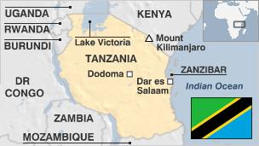
The City of Dar-es-Salaam Profile

Slide 4
City of Dar-es-Salaam: Facts
city’s land area is 538 square miles,
population density 8,100 people per square mile.
population growth rate of 4.9% per annum

Slide 5
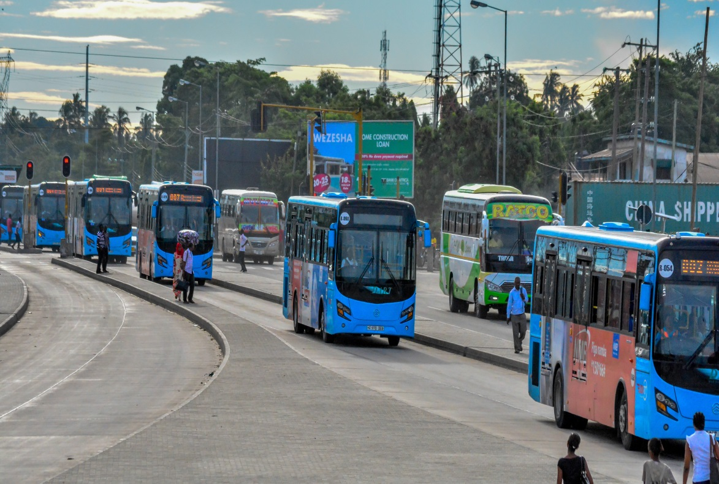
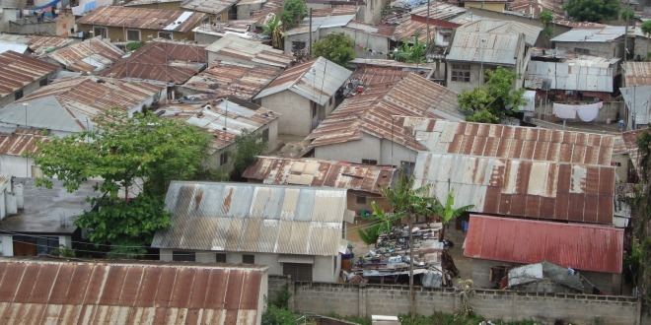
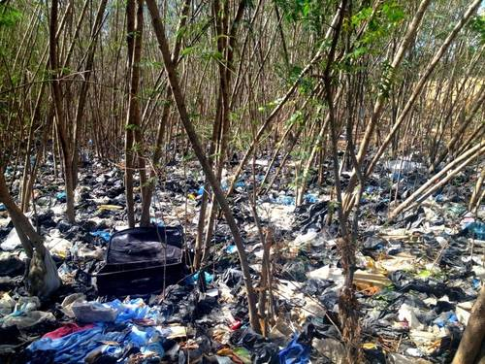
Dar-es- Salaam: Some of the city Challenges

Slide 6
Dar-es- Salaam: Some of the city Challenges (health)

Slide 7
Dar-es- Salaam: Some of the city Challenges
Solid Waste generation and disposal
solid waste generation 3100 Tonnes/ Day amount collected and disposed off 1200 Tonnes/ Day (39%)
all dumpsites in the city generate a lot of fire/smoke an environmental hazard.
population growth rate of 4.9% per annum

Slide 8
Dar-es- Salaam: Some of the city Challenges
Air Pollution-major sources - motor vehicles, industrial pollution and residential burning of fossil fuels.
bus transport that accounts for about 60% of the modal split
A badly maintained older vehicles can emit 100 times the pollutants of a properly maintained modern vehicle (ETC,1995).

Slide 9
Dar-es- Salaam: Some of the city Challenges
Sand Mining undertaken in undesignated areas for such activities creates conflicts between residents and city authorities
affect the aesthetic features of the area and potentially exacerbated soil erosion and resulted into a loss of productive land.

Slide 10
Dar-es- Salaam city Challenges
Flooding risk mitigation
Informal land use, settlements and multi-use
80% residents in informal settlement (UNICEF 2013)
The informal and unplanned settlements (Slums) with poor infrastructure, services and poor sanitation lead to a number of outcomes:
Floods and disease transmission i.e. cholera: 2% cholera incidence with % increase in population density

Slide 11
Dar-es- Salaam city Challenges
Informal economy and industrialization
Higher prices/ cost of living and lower ownership rate
Youth unemployment

Slide 12
Dar-es- Salaam City: Universities
The Universities in Dar-es-Salaam are of various kinds; some are specialised and non-specialised, private and public. They include: -
Ardhi University (ARU, Public, specializing in Land)
International Medical and Technological University (private)
Muhimbili University of Health and Allied Sciences (Public)
St. Joseph University in Tanzania (private, specialising in Engineering)

Slide 13
Dar-es- Salaam City: Universities
Hubert Kairuki Memorial University (health, Private)
Tumaini University (Private )
The Open University of Tanzania (OUT, Public)
University of Bagamoyo (private)
University of Dar-s Salaam
Kampala International University

Slide 14
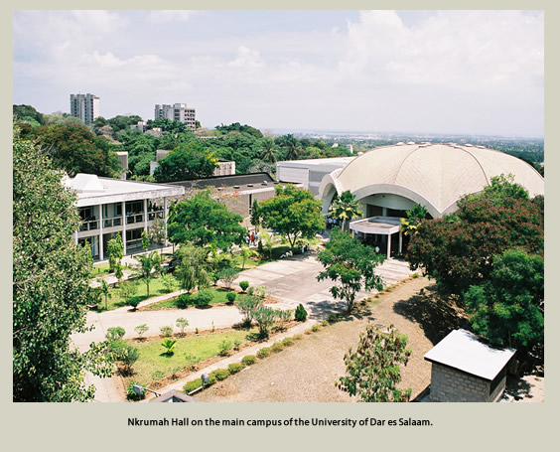
Choice of universities:
The University of Dar-es-Salaam
Reasons
oldest university, UDSM seems to be relatively well established
Most likely to represent most of the features found in other public universities within the country
Available resources

Slide 15
Methodology
standard interviews and focus group discussions with key people at the university and at the city in order to assess the strengths, weaknesses, opportunities, and threats (SWOT) in relation to the university engagement role.
In particular the following key people were interviewed:
The outgoing vice Chancellor (1)
The Dean University DSM Business School (1)
The Principal – College of Engineering (1)
The principal – College of Social Sciences (1)
The Principal College of Natural and Applied sciences (1)
Director of University Consultancy Bureau (1)

Slide 16
Methodology
Other participants included the Mayor of the City of Dar-es-Salaam (n=1) and officials from the Tanzanian Surface and marine Transport Regulatory Authority (SUMATRA, n= 2)
The inclusion of different departments seemed to be important due an assumption that most engagement activities are talking place at unit level. The 4 academic disciplines were selected based on Becher’s (1989) modified classification of Biglan’s (1973) six-fold model of classifying academic disciplines.

Slide 17
Preliminary findings: Presence or absence of engagement activities
From the perceptions of people in the city, there were no or inadequate university engagement activities. The majority of the activities were in terms of consultancies
From the perspective of the universities some few engagement activities existed. However to a greater extend they were ad hoc
University is working with local employers to ensure that young people are receiving the correct training for current labour market demands (EB, TSL & tracers study)

Slide 18
Some of the engagement activities
Directorate of public services.
Assisting in disaster management e.g. assisting primary schools which were affected in the city when the ammunition dump exploded in 2009.
consultancies
Participation into annual research exhibition week to showcase research activities and innovations to the public.
Participation into other university exhibitions.
Organises the Mwalimu Nyerere Chair annual festivals inviting stakeholders to discuss various issues ( e.g. climate change, Gender, leadership and democracy).

Slide 19
Some of the engagment activities
University of Dar-es-Salaam Entrepreneurship Centre (UDEC) -provision of entrepreneurial skills.
University engages with ministries -ministry of finance, ministry of lands, climate change etc, government agencies and businesses.

Slide 20
Some of the engagment activities
Accessibility to university services
Access to water services at the university,
use of health centre facilities,
Surrounding communities offering students accommodation
banking facilities
university library
transport
play grounds
the university offers investment opportunities to people in the city to serve students, by building residential facilities and do businesses with the university community (Mlimani city mall)

Slide 21
Some of the engagment activities
University have agreements with local economy/businesses
UCB Bureau for Industrial cooperation –fabrication and sell machines, workshops.
UCB, NSCOB & Central Science Workshop offering regular professional training and development in science to communities
The university also has agreement with some companies such as Companies e.g. TOTAL.

Slide 22
Preliminary findings: Perception about types of engagement activities
University staff appointments in advisory bodies
Engaging through the research projects being done by colleges/ departments
Research projects target communities e.g. fish net

Slide 23
Preliminary findings: barriers to effective university engagement
Too much focus on theoretical/ abstract teaching and sometimes the teachings which is irrelevant
Status distance – some professors being unreachable
Contradiction between focus on the city and focus on national issues
Lack of resource's
Lack of awareness
Lack of proper policies and structures
Lack of powers and jurisdiction among cities
One of the basic problems however is that universities are not good at running businesses.

Slide 24
Preliminary findings: strategies' for effective engagement
reducing the existing gap between universities and cities
Having a strategic plan /structures / policies in place
Set recourses for implementation of engagement activities

Slide 25
Possible opportunities and the way forward
the Universities and cities realising the need to change their traditional practices and formalise their engagement role
Open up for a greater University engagement role

Slide 26
Thank you !
Asante Sana! (Swahili)!

